Slide 1
Fridge Friend
Your friendly kitchen inventory tracker
Developed by K. Wolley, S. Sharma, P. Conley

Slide 2

Fridge Friend
Tool Review: Slack
Use Cases:
Project tracker
Communication
Scheduling
Overall Evaluation by Team: 5/5
Pro’s:
Free
Easy to use
Numerous API Integrations
Con’s:
Default notification settings
Hard to find specific dates without integrations

Slide 3

Fridge Friend
Tool Review: GitHub
Use Cases:
Project tracker
Version control
Overall Evaluation by Team: 5/5
Pro’s:
Free
Easy to use
Numerous API Integrations
Con’s:
Merge conflicts

Slide 4

Fridge Friend
Tool Review: HTML, CSS, JS
Use Cases:
programming languages and frameworks
Overall Evaluation by Team: 5/5
Pro’s:
Free
Easy to use
Lots of documentation available
Con’s:
Too much documentation available - difficult to stay within scope of project

Slide 5

Fridge Friend
Tool Review: VS Code
Use Cases:
Code editor
Overall Evaluation by Team: 5/5
Pro’s:
Free
Easy to use
Auto-fill code and instructions
Con’s:
None

Slide 6

Fridge Friend
Tool Review: Django
Use Cases:
database
programming language and framework
Overall Evaluation by Team: 5/5
Pro’s:
Free
Easy to use
Numerous API Integrations
Con’s:
Requires more advanced programming ability levels

Slide 7

Fridge Friend
Tool Review: IntelliJ
Use Cases:
database
testing
auto-documenter
programming language and framework
code editors
Overall Evaluation by Team: 5/5
Pro’s:
Free for Students
Live code editor, analysis and refactoring
Browser preview
Code assist
Numerous plugins
Con’s:
Difficult to test php files

Slide 8

Fridge Friend
Tool Review: Heroku
Use Cases:
Project tracker
Version control
database
testing
auto-documenter
deployment environment
programming languages and frameworks
code editors
Overall Evaluation by Team: 5/5
Pro’s:
Free
Easy to use
Numerous API Integrations
Con’s:
Limits on data usage
Requires precise coding style and documentation

Slide 9
Fridge Friend
Challenges + Fixes
Scheduling:
Slack communication
Periodic meetings
“Eyes bigger than stomach”:
Tutorials
Tasks assigned to individuals
Timing for due dates:
Course material released after project initiated. Most material learned individually on a need to know basis.
Continued project development after class ends

Slide 10
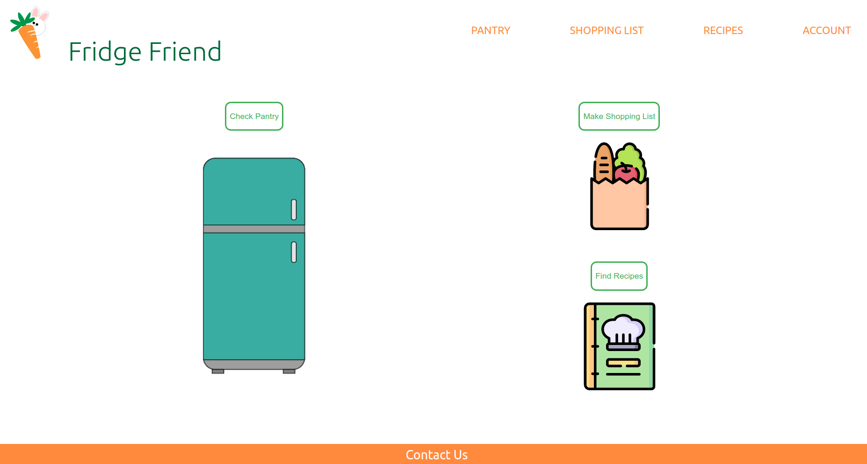
Fridge Friend
Demonstration

